Slide 1
CSE322
CONSTRUCTION OF FINITE AUTOMATA EQUIVALENT TO REGULAR EXPRESSION
Lecture #9

Slide 2
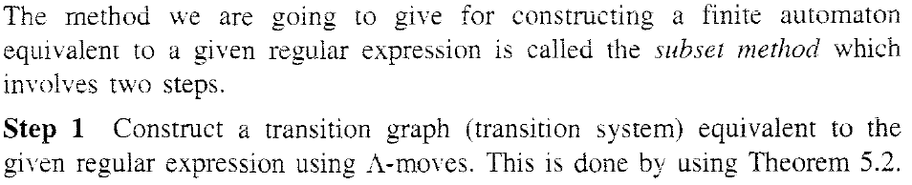
STEPS

Slide 3
PROBLEM

Slide 4
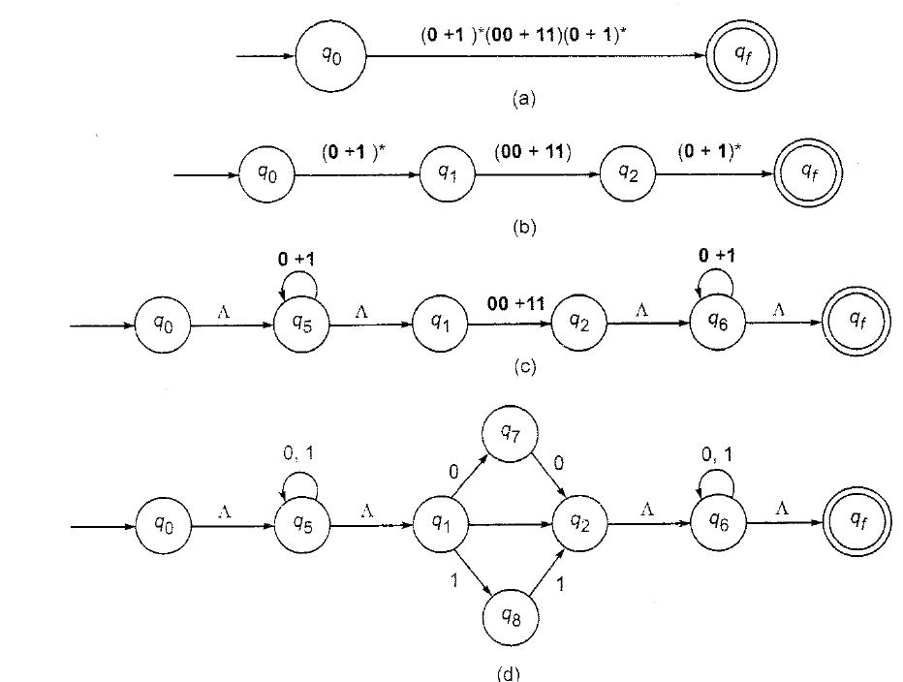
SOLUTION

Slide 5
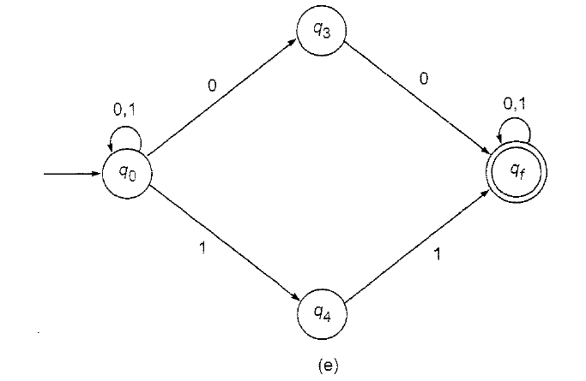
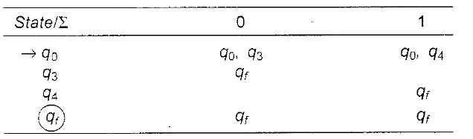
SOLUTION

Slide 6
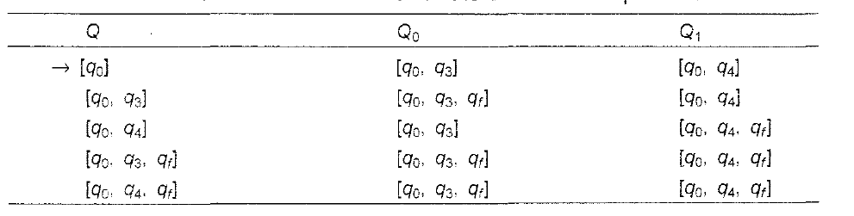
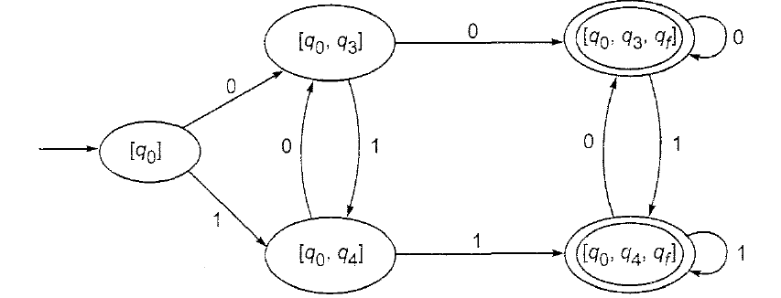
SOLUTION

Slide 7
CSE322
EQUIVALENCE OF TWO FINITE AUTOMATA AND REGULAR EXPRESSION
Lecture #9

Slide 8
EQUIVALENCE OF TWO FINITE AUTOMATA
Two finite automata are over∑ are equivalent if they accept the same set of string over input ∑.
When two finite automata are not equivalent ,there is some string w over ∑ satisfying the following: one automaton reaches a final state on application of w, whereas other automaton reaches a non final state.

Slide 9
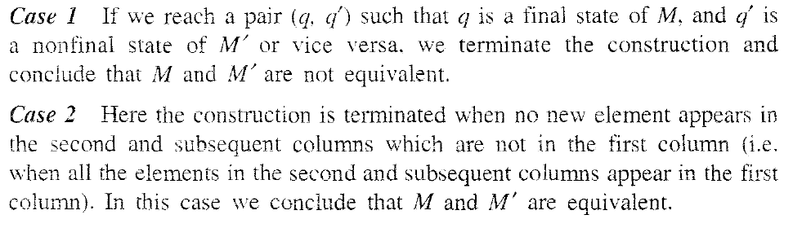
CASES

Slide 10
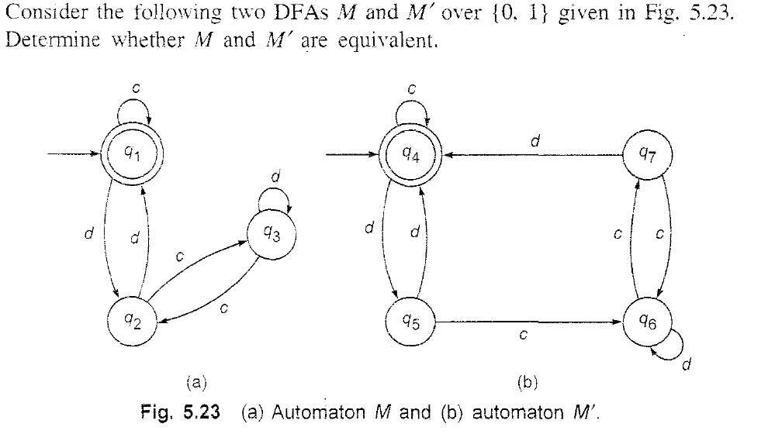
PROBLEM

Slide 11
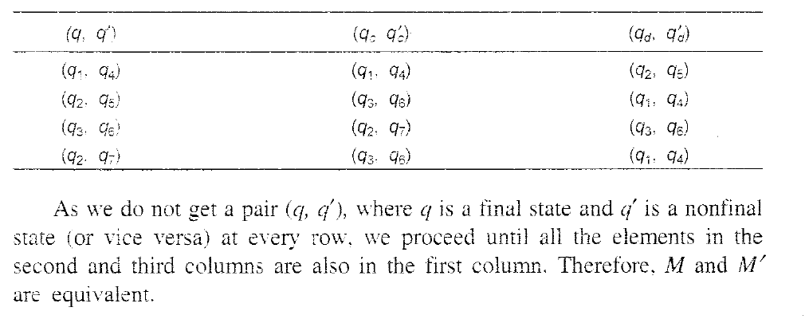
SOLUTION

Slide 12
EQUIVALENCE OF TWO REGULAR EXPRESSION
The regular expressions P and Q are equivalent iff they represent the same set. Also, P and Q are equivalent iff the corresponding finite automata are equivalent.

Slide 13
PROBLEM
PROVE
(a+b)*=a*(ba*)*

Slide 14
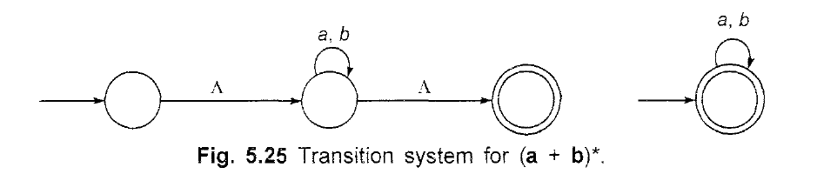
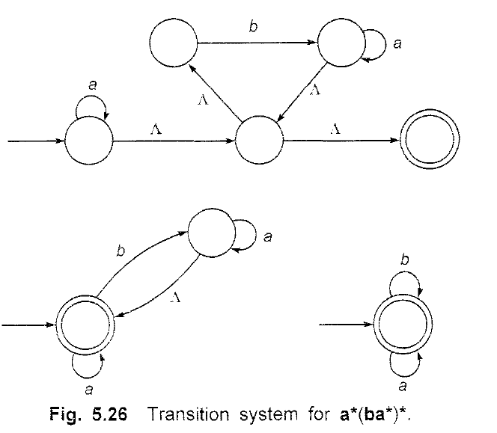
SOLUTION

Slide 15
Closure properties of Regular set
Set Union
Concatenation
Closure(iteration)
Transpose
Set intersection
Complementation

